Slide 1

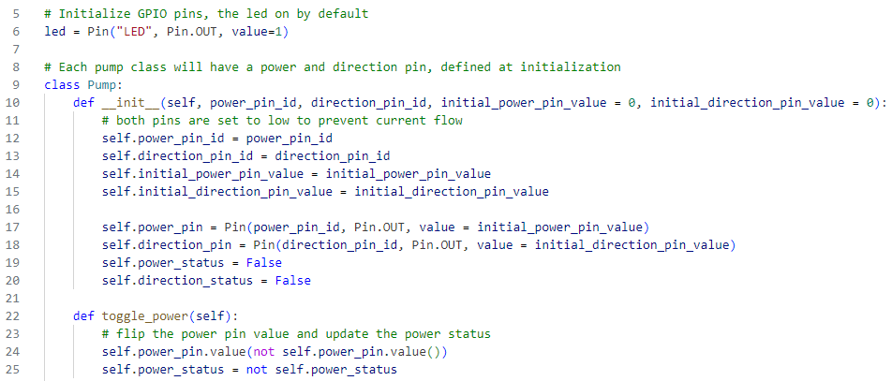

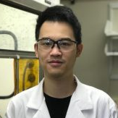
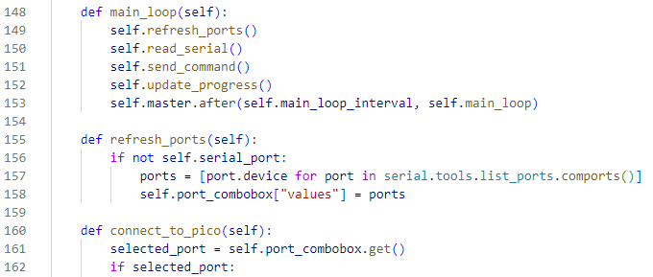
Peristaltic Pump Remote Control – A Python User Interface
Scripts have been written for interfacing the Pi Pico with pumps and the PC terminal.
Tom has built a GUI for pump control, so interfacing with this code is unnecessary.
Pico integration with defined pump objects:
PC integration with the Pi Pico
Tom Tan, Stahl group
Thanks also to Dr. Dylan Walsh for helpful discussions
Notes:
MoS2 is used for hydro-desulfurization; can be used in a screen here. Can check ChemE stock room, Hermans group, and/or Huber group if it moves up in priority.

Slide 2
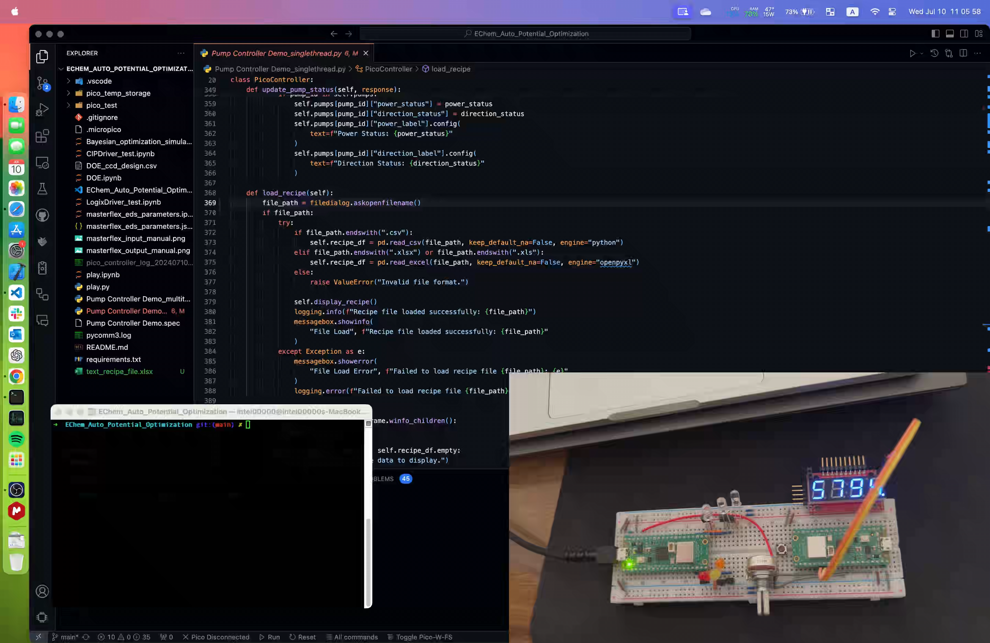
Peristaltic Pump Remote Control – A Python User Interface
A demo for the recipe function
Thanks also to Dr. Dylan Walsh for helpful discussions
Notes:
MoS2 is used for hydro-desulfurization; can be used in a screen here. Can check ChemE stock room, Hermans group, and/or Huber group if it moves up in priority.

Slide 3
Peristaltic Pump Remote Control – A Python User Interface
Future improvement
Adjust parameter (e.g. command issue interval) for actual pump device.
Develop recipe file for actual experiment, test run on EasyMax.
Add safety monitoring and improve error handling.
Add sensor monitoring (e.g. thermocouple).
Add remote monitoring and data logging (e.g. a webpage)
Dynamic pump addition and editing (make it more general)
Incorporate into chem workshop auto-rxn package if needed.
Switch from sequential command to multithread parallel command. (challenging, need rewrite in C)
Control EasyMax platform? (close-source, depending on their response)
Currently, we envision clicking two start buttons at the same time (one in iControl, other in this script) to run a series of experiments and collect sample.
Time point (min) | Pump 1 | Pump 2 | Pump 3 | Valve 1 | Valve 2 | Valve 3 | Notes
0 | On | Off | Off | CW | CW | CW | Start initial fill with reaction solution
0.25 | Off | on | on | CCW | ccw | ccw | For testing
0.5 | On | On | Off | cw | ccw | cw | For testing
0.75 | Off
1 | on | off | on
Thanks also to Dr. Dylan Walsh for helpful discussions
Notes:
MoS2 is used for hydro-desulfurization; can be used in a screen here. Can check ChemE stock room, Hermans group, and/or Huber group if it moves up in priority.

